Slide 1
Serving Files

Slide 2
Serving Files
io.Copy
http.ServeContent
http.ServeFile
http.FileServer

Slide 3
io.Copy

Slide 4
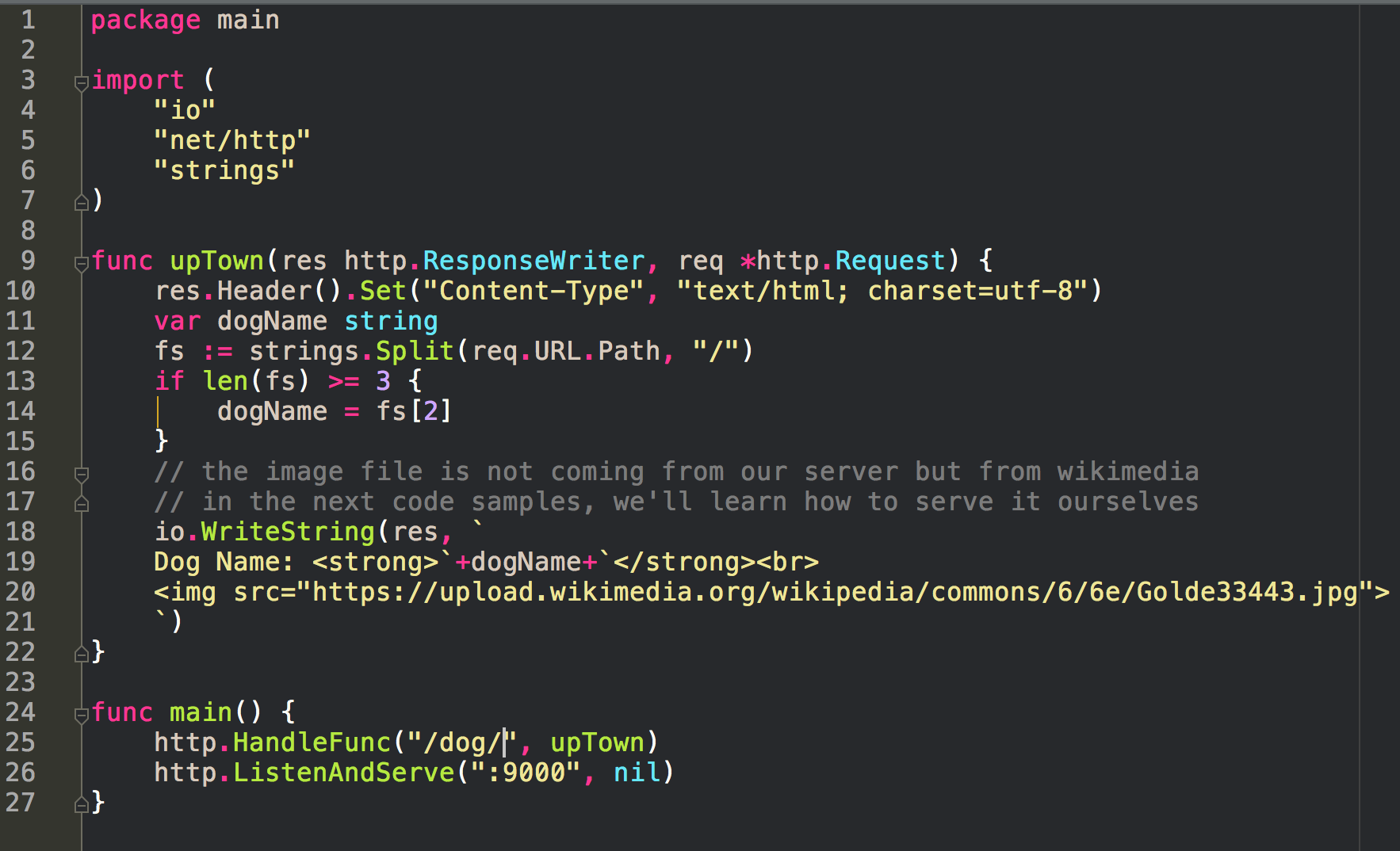
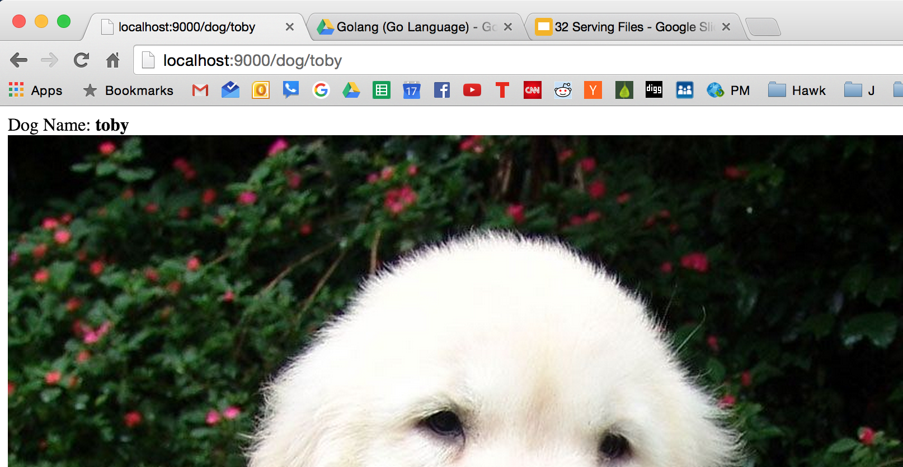
image served from wikimedia …
how do I serve it from my own server?

Slide 5
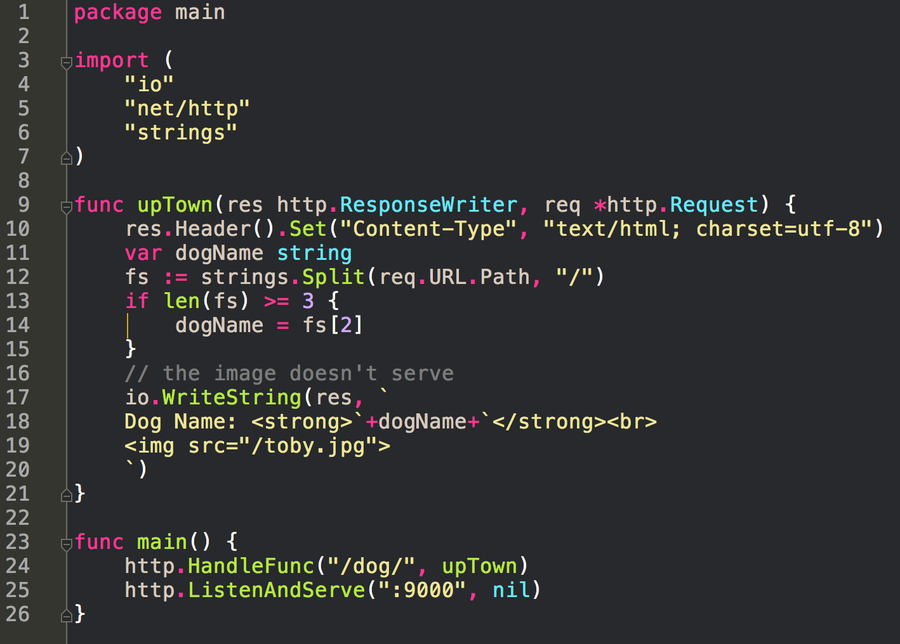
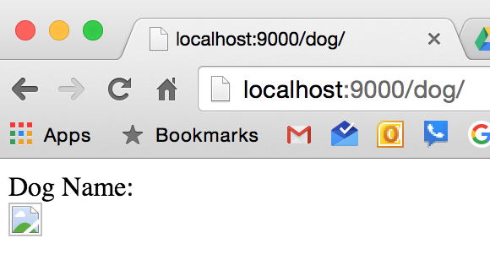
attempt to serve image ourselves
unsuccessful

Slide 6
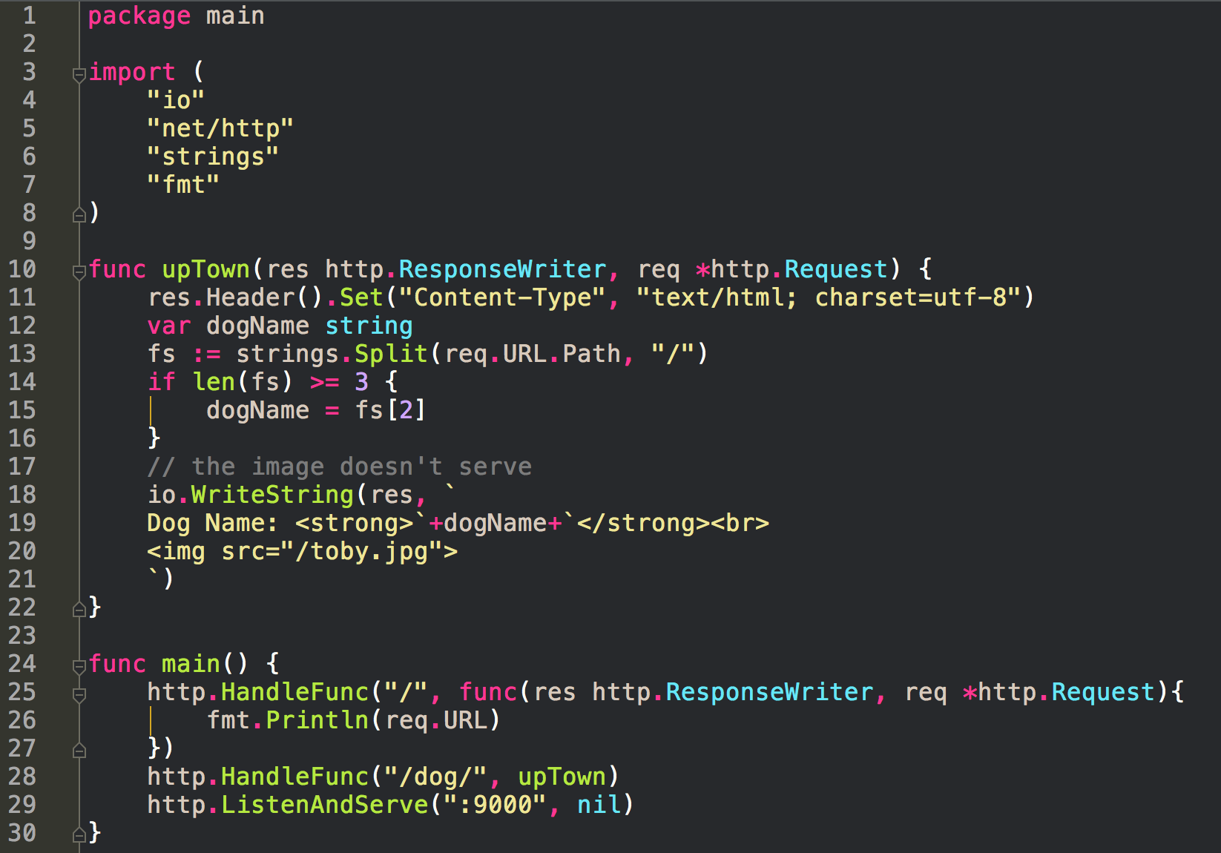
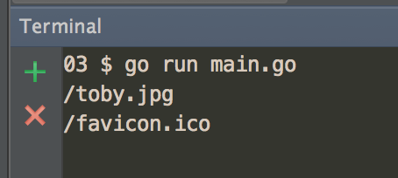
Add route to see
all requests to our server

Slide 7
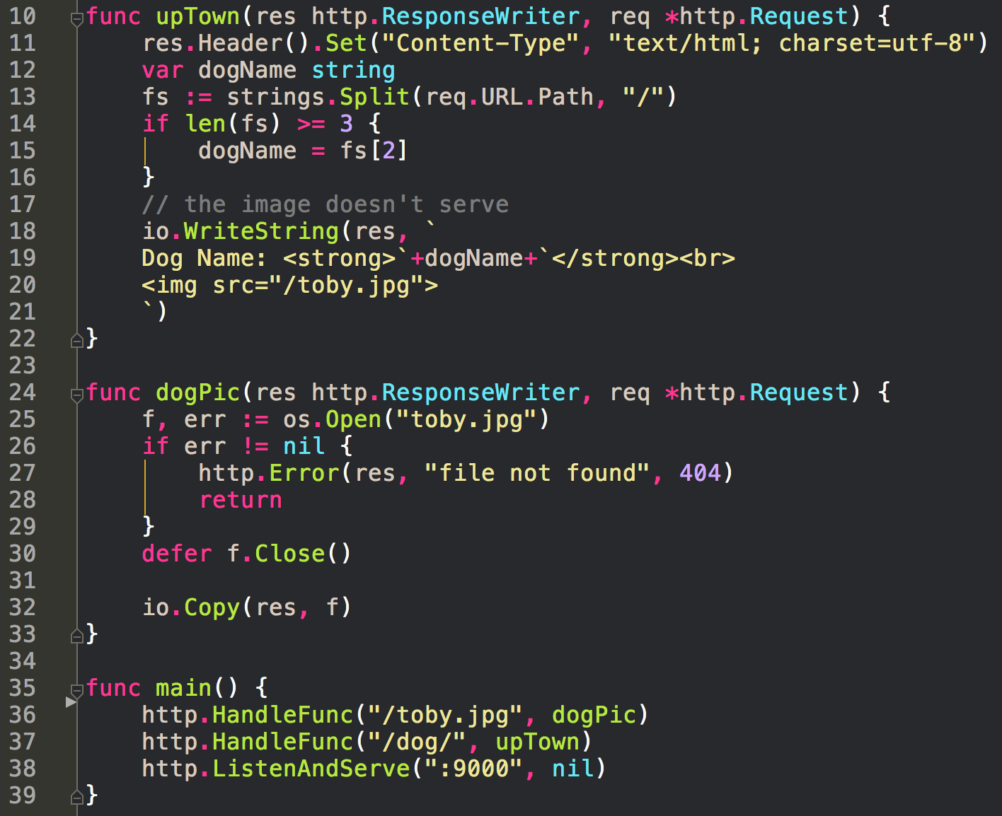
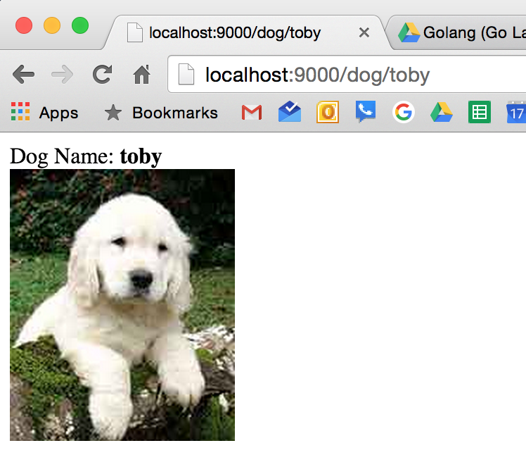

Slide 8
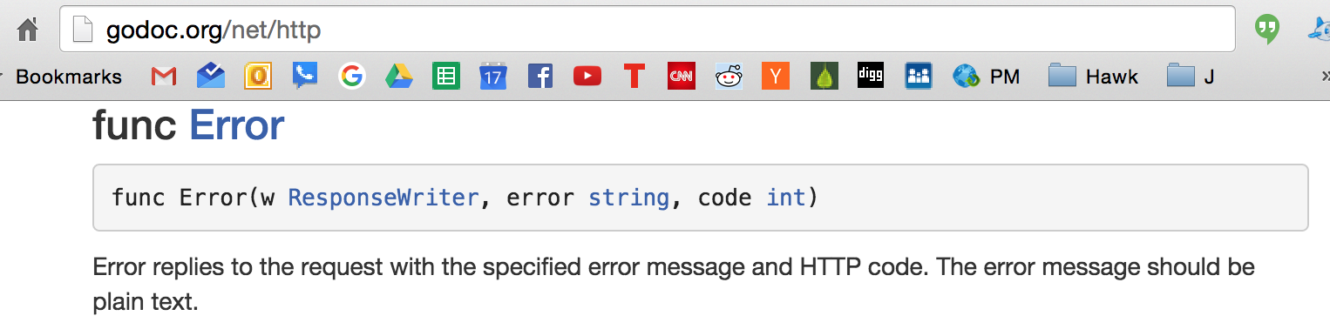

Slide 9
We should be setting the content type
We should be using an ETag
We could do all of this, but there’s a much easier way ...

Slide 10
http.ServeContent

Slide 11
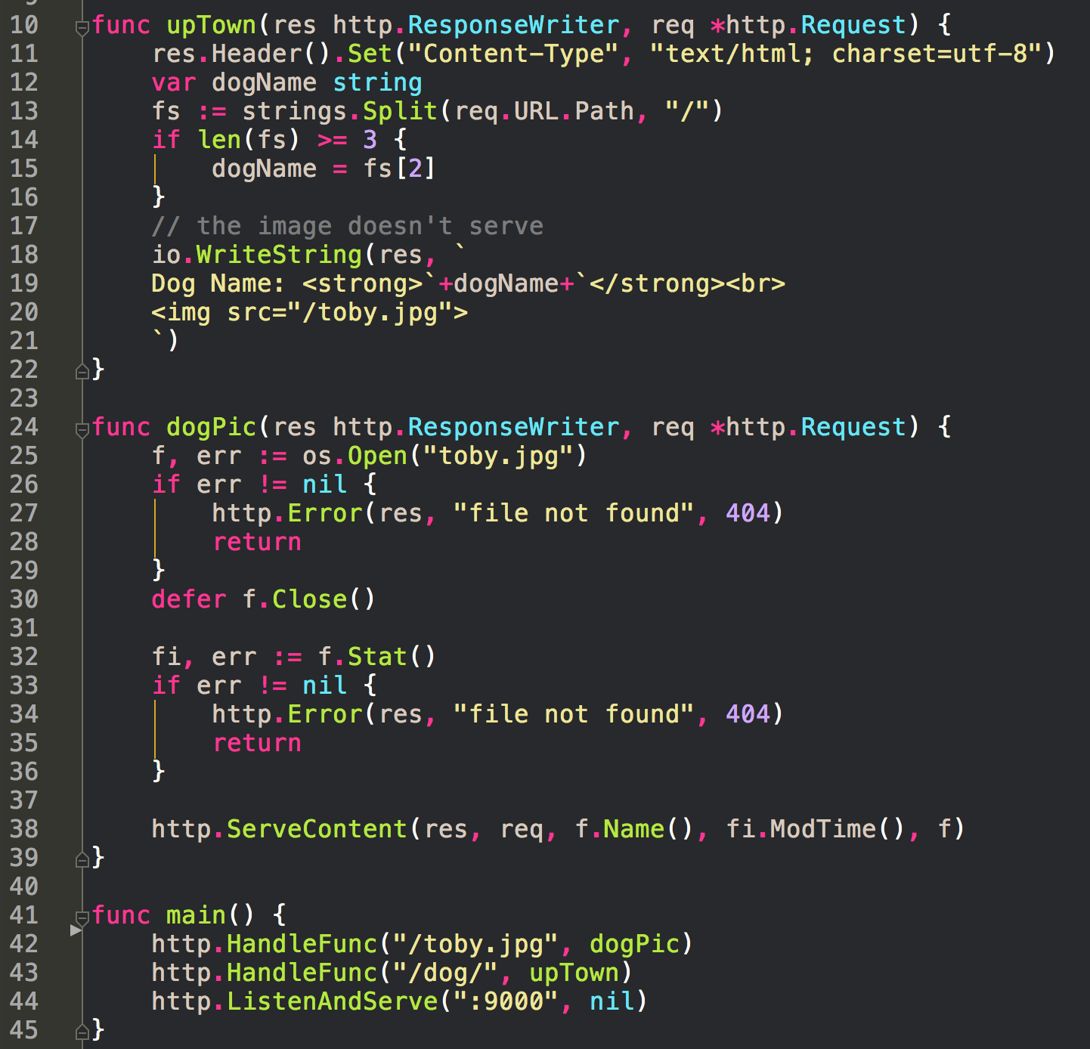
ServeContent
fills in the headers for you

Slide 12
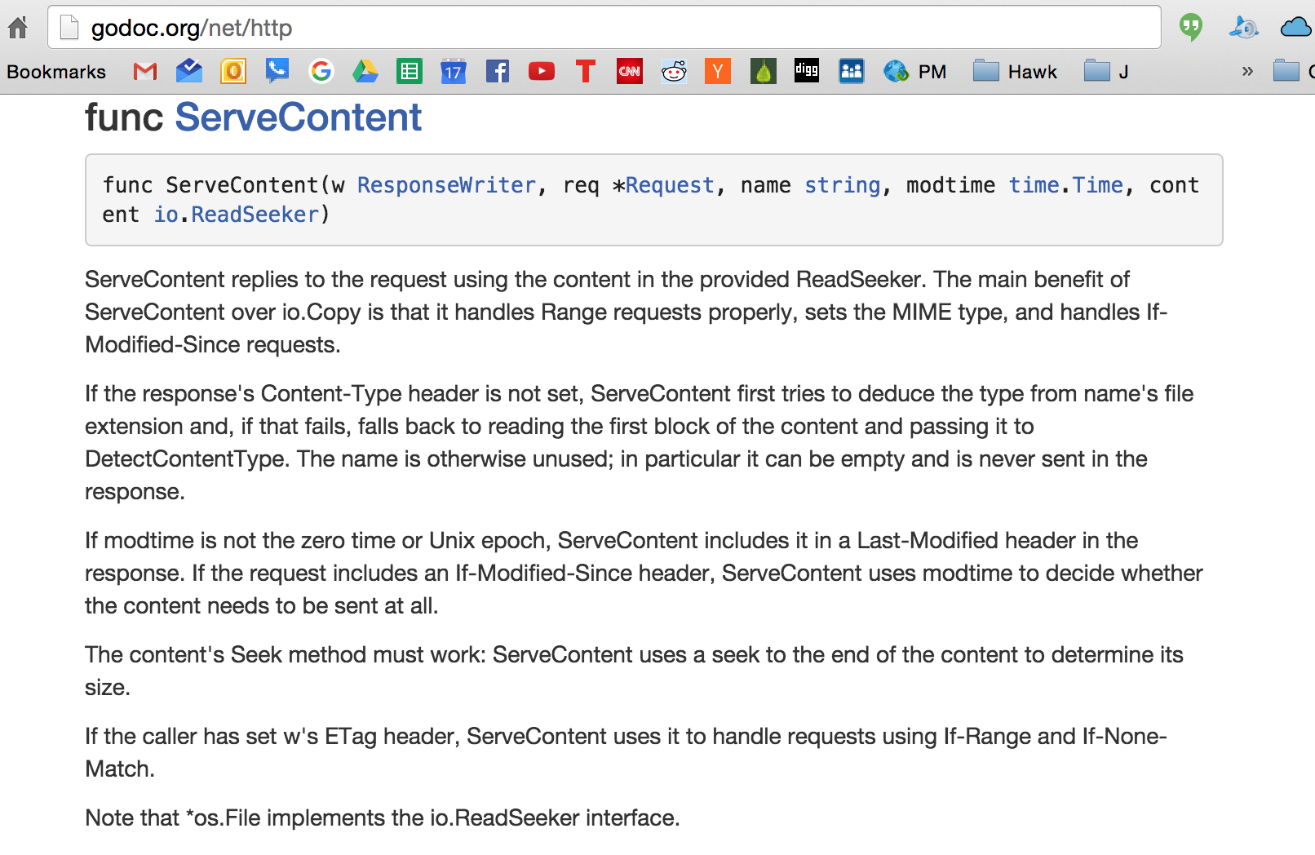
The name of the file
os.*File implements io.ReadSeeker interface
We can pass a *File in here
The last time the file was modified
ServeContent needs *Request
to look at the request that came in
to see if ETag, etc

Slide 14
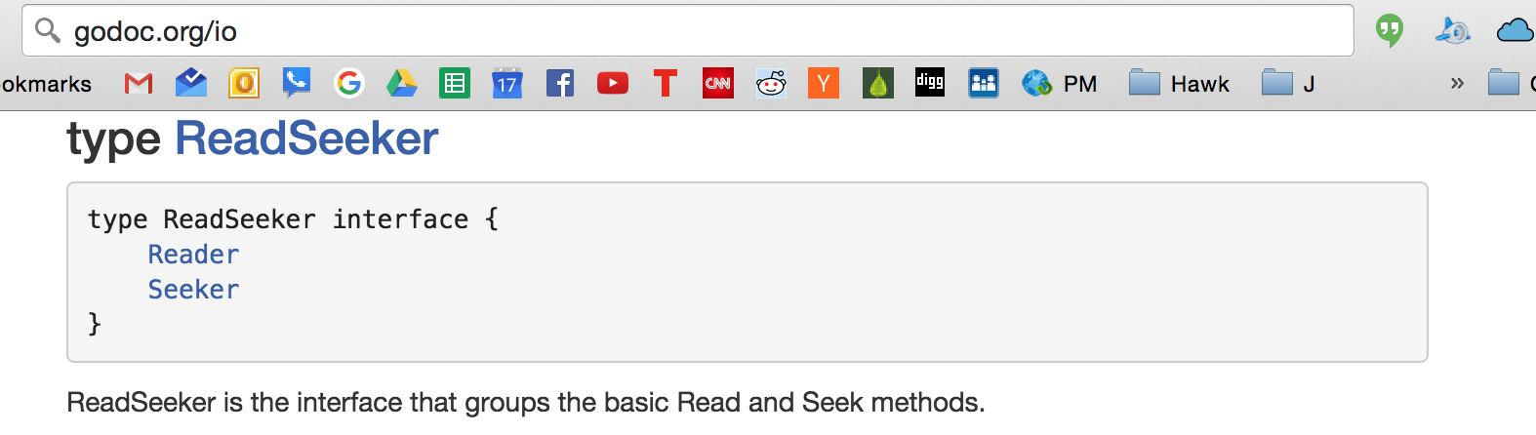
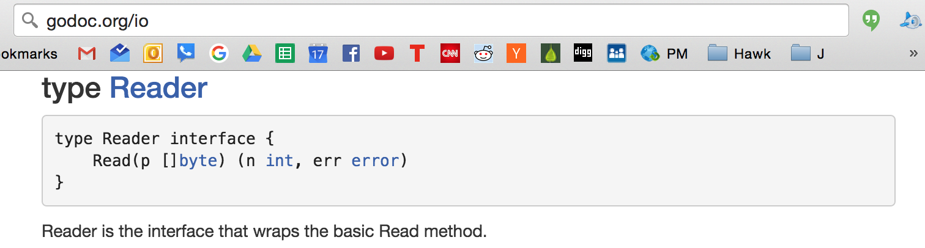
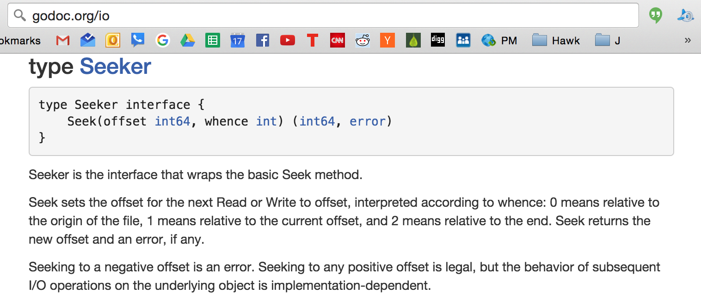

Slide 15
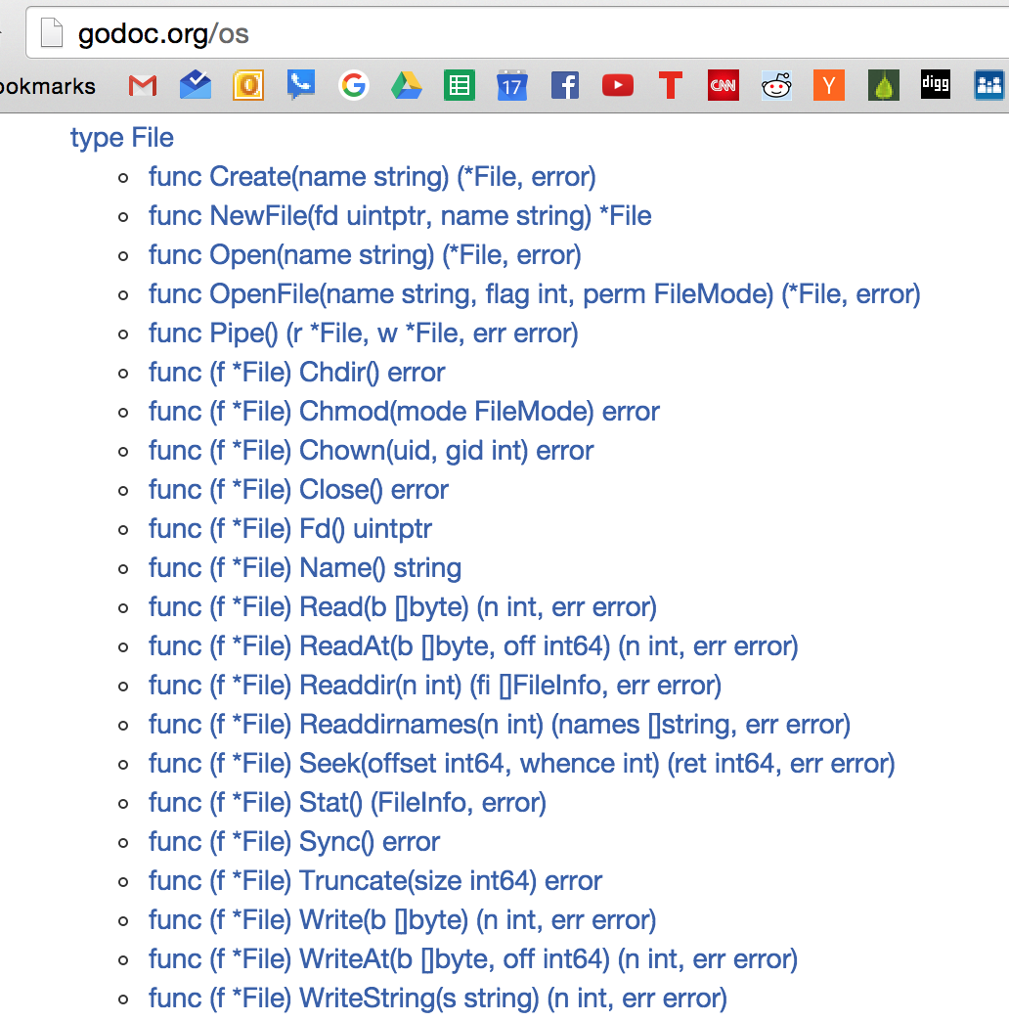

Slide 16
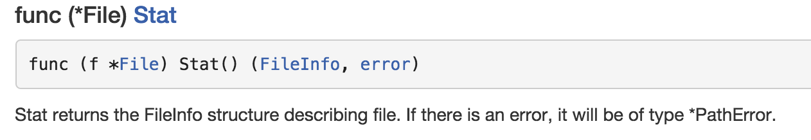
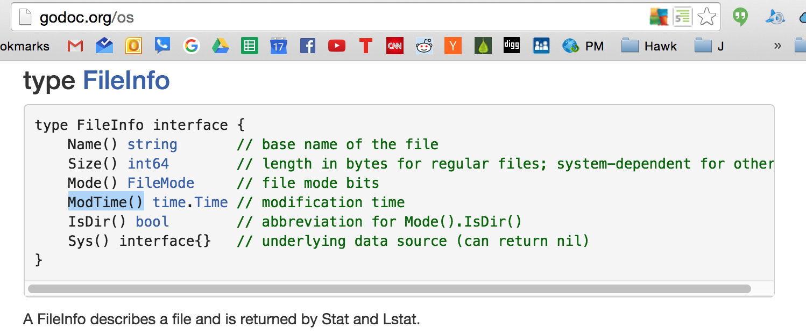

Slide 17
an even better, easier way ...

Slide 18
http.ServeFile

Slide 19
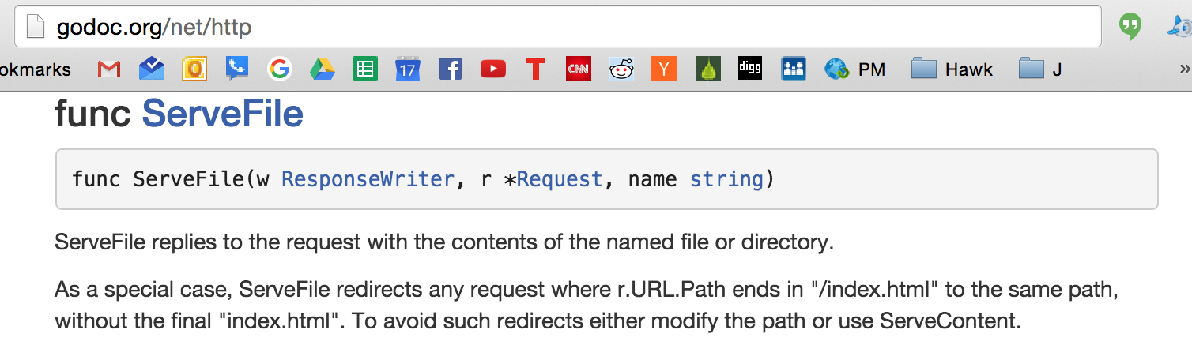

Slide 20
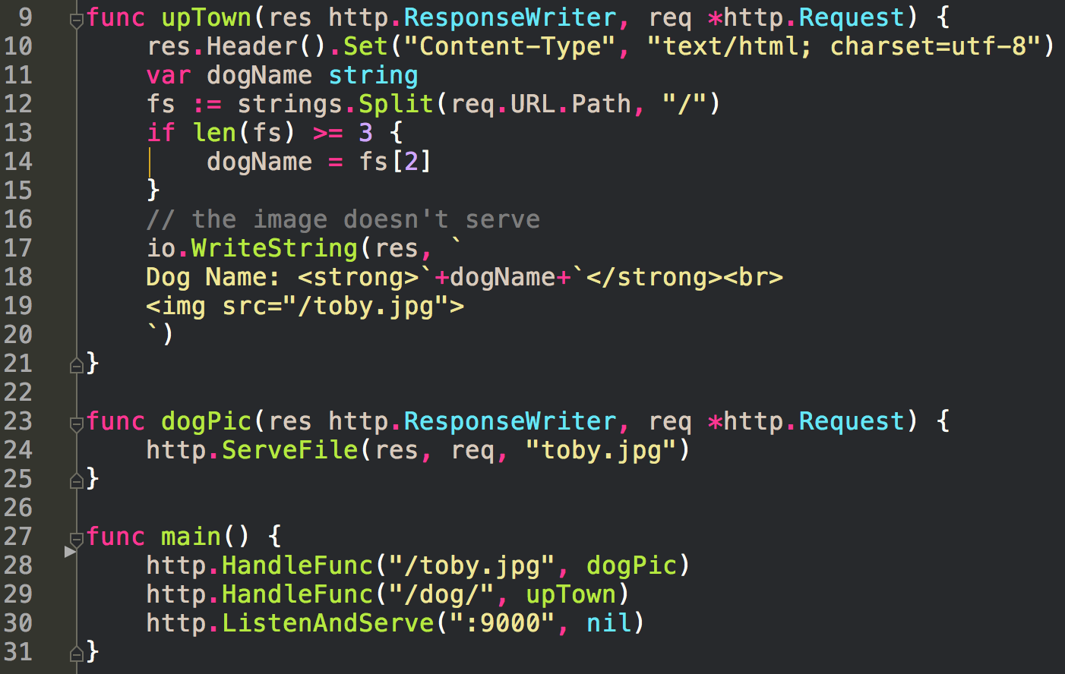

Slide 21
yet still, an even better, easier way ...

Slide 22
http.FileServer

Slide 23
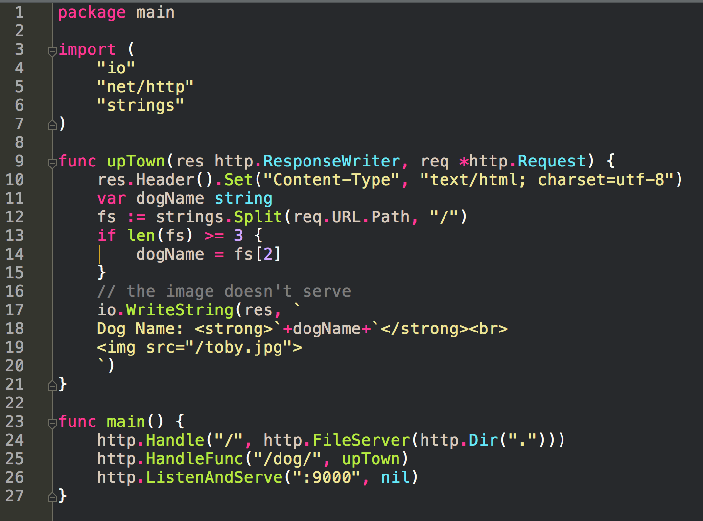
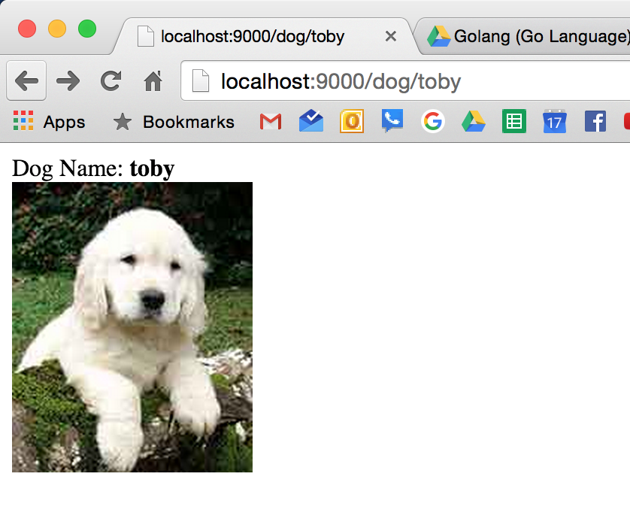
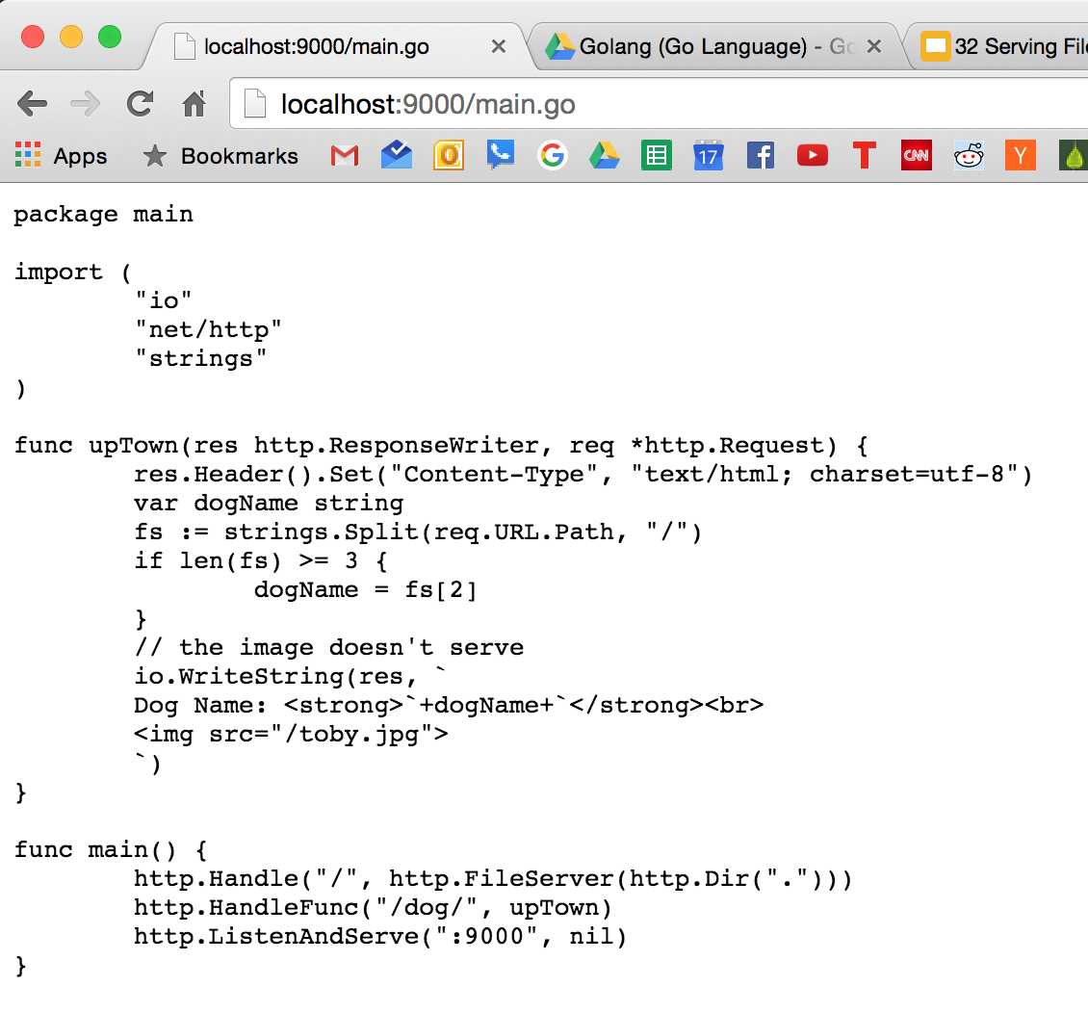

Slide 24
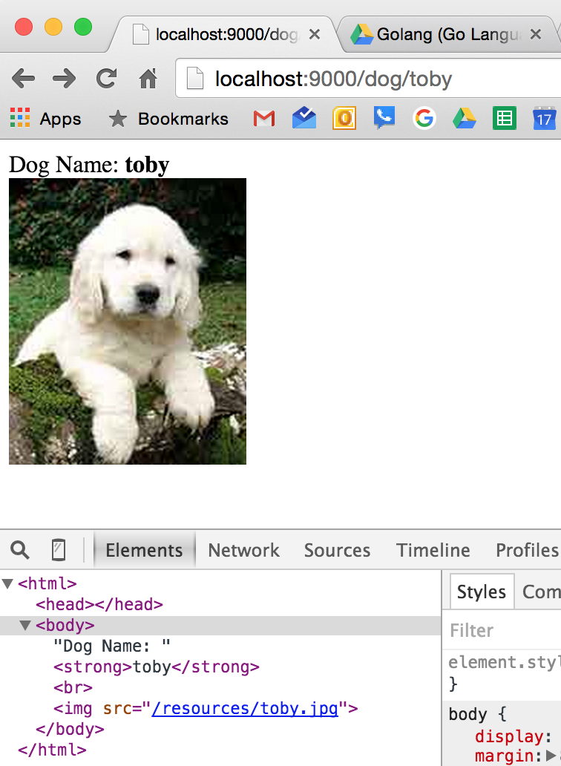
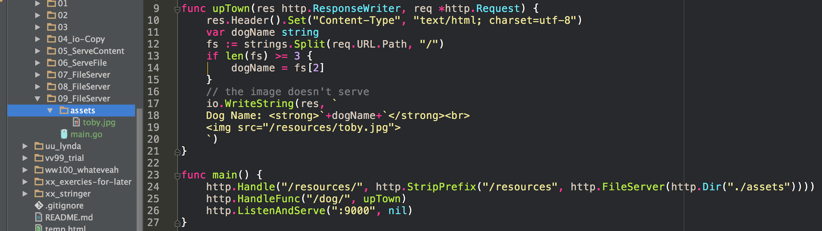
we ask for “/resources/toby.jpg”
this matches the routing on line 24
the file that we want is called “toby.jpg” not “/resources/toby.jpg”
we therefore need to strip “/resources” from what we’ve requested, the URI “/resources/toby.jpg”
This leaves us with just “/toby.jpg”
the FileServer then looks in “./assets” for “/toby.jpg”, eg, it looks for “./assets/toby.jpg”
even though we asked for “/resources/toby.jpg” in our HTML
on our server we served “./assets/toby.jpg”
Another way to say this:
I’m asking for “/resources/toby.jpg”
Where is file server going to look for this?
It is going to look in “./assets”
That means what I’m attempting to serve back to the client is
“./assets/resources/toby.jpg”
FileServer will serve files from
the specified FileSystem directory

Slide 25
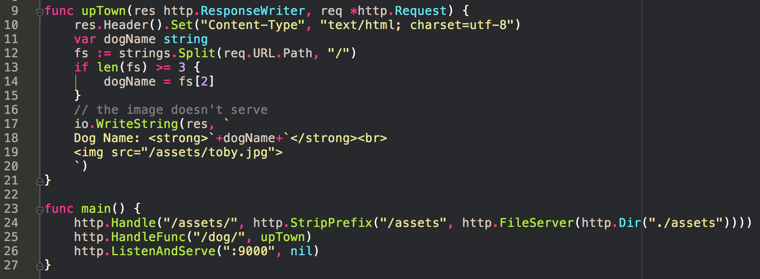
we ask for “/assets/toby.jpg”
this matches the routing on line 24
the file that we want is called “toby.jpg” not “/assets/toby.jpg”
we therefore need to strip “/assets” from what we’ve requested, the URI “/assets/toby.jpg”
This leaves us with just “/toby.jpg”
the FileServer then looks in “./assets” for “/toby.jpg”, eg, it looks for “./assets/toby.jpg”

Slide 26
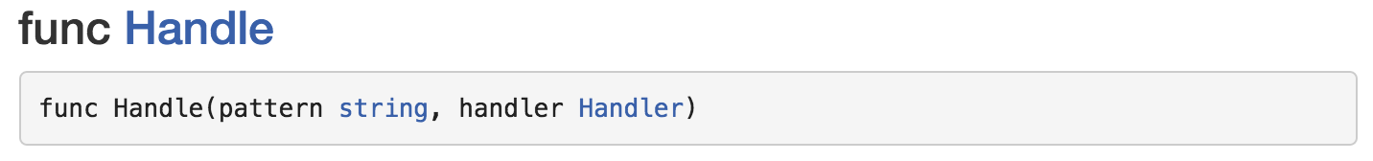
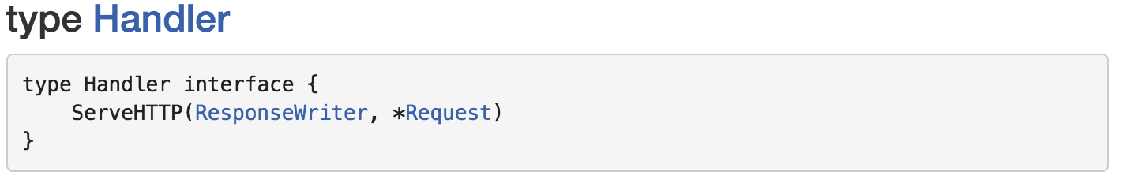
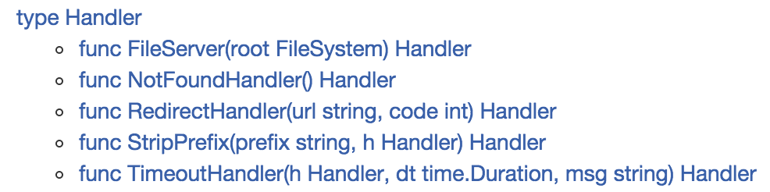
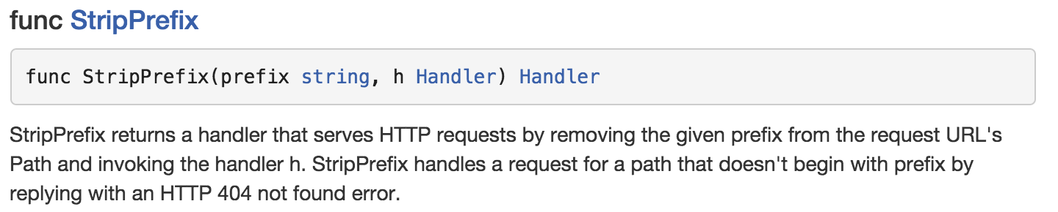
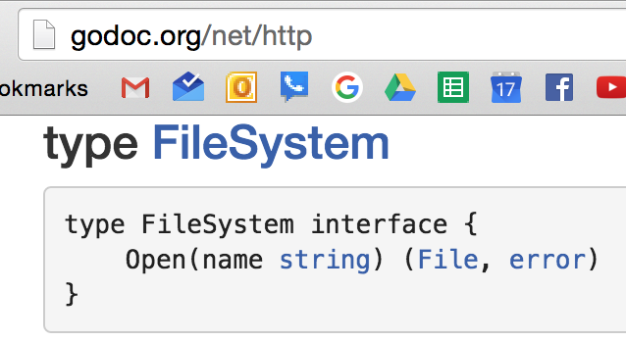
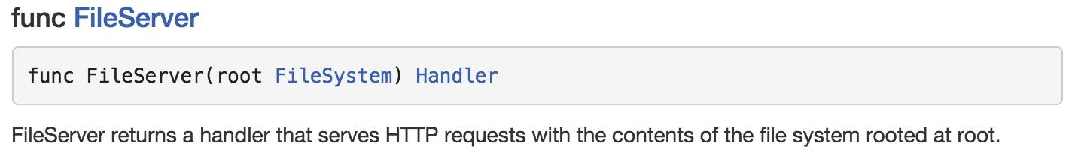
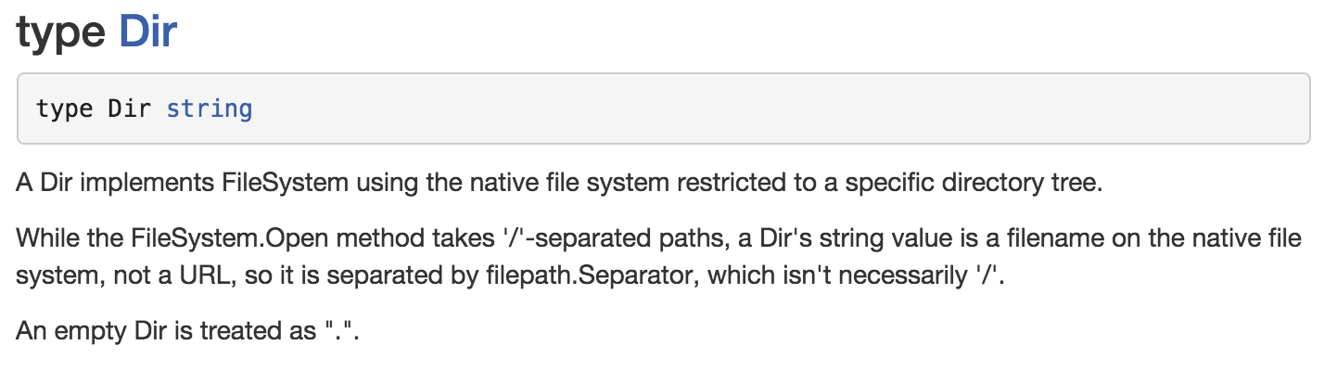
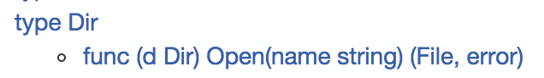
conversion

Slide 27
exercise
Create a static http server (perhaps named static-http) that serves the contents of the current working directory.

Slide 28
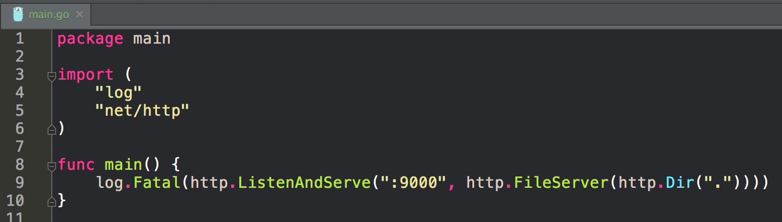
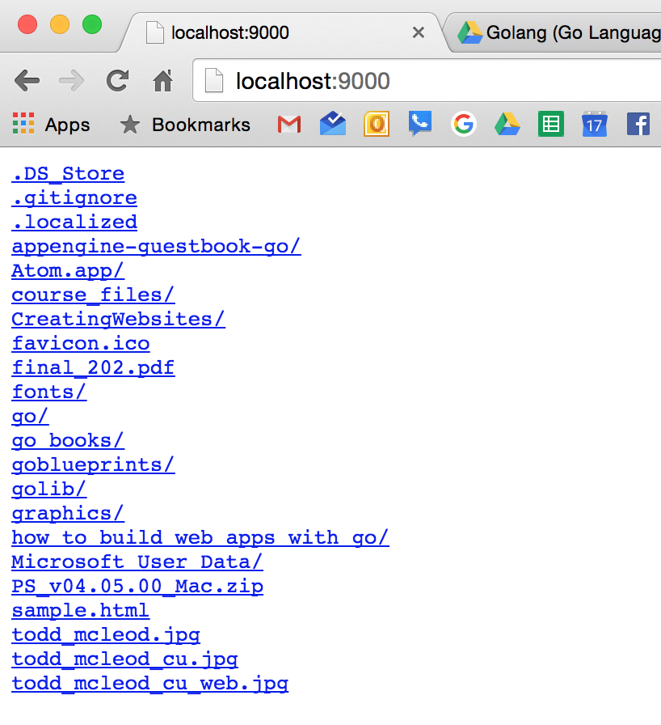
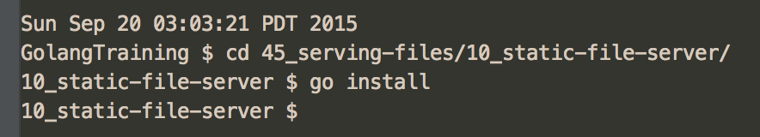
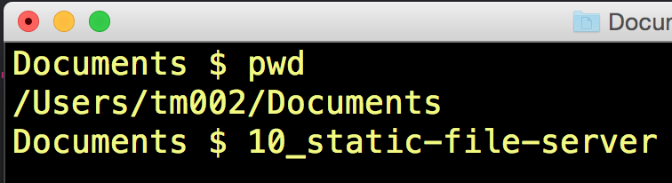

Slide 29
Don’t ever trust a file from a user
file inclusion vulnerability

